Slide 1

SSL Striping

Slide 2
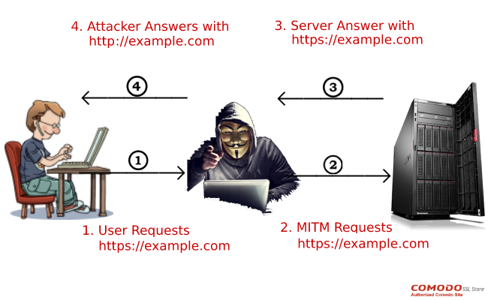
SSLstrip is a protocol-downgrade attack that allows an attacker to intercept the contents of an exchange that would normally be confidential.
It can occur when an exchange that is supposed to result in an encrypted connection is initiated insecurely (non-encrypted)

Slide 3

History
The creator of SSL strip vulnerability is Moxie Marlinspike, a well-known American computer security researcher.
In 2009, he spoke about this dangerous SSL weakness for the first time at the Black Hat information security event.
According to Marlinspike’s presentation, the exploitation of this vulnerability is very serious threat for the privacy of our digital credentials since it can happen in real time, undetected, and targets whatever secure sites people are browsing to at any moment.
It doesn't require multiple certificates and once the attacker gets his “dirty work” done, he can switch the victims back to a normal traffic stream.

Slide 4
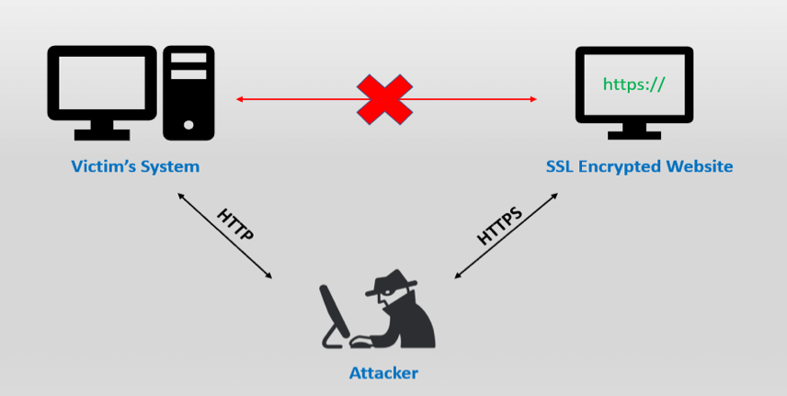
How the SSL strip attack works
In order to “strip” the SSL, an attacker intervenes in the redirection of the HTTP to the secure HTTPS protocol and intercepts a request from the user to the server.
The attacker will then continue to establish an HTTPS connection between himself and the server, and an unsecured HTTP connection with the user, acting as a “bridge” between them.

Slide 5
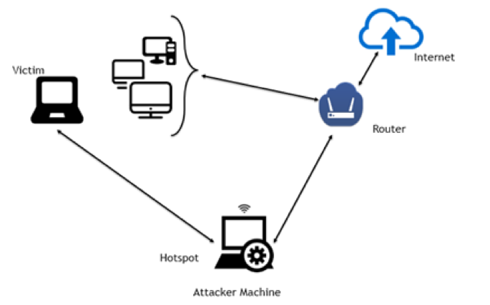
Why are open Wi-Fi hotspots dangerous?
SSL Strip attacks can be implemented in a number of ways. The most common method is by creating a hotspot and allowing the victims to connect to it.
Many attackers establish fake hotspots with names similar to legitimate hotspot names, for example, “Starbucks Coffee” instead of “Starbucks”.
Unaware, the user connects to the malicious hotspot. Once the user tries to connect to the server, the attacker uses his control over the hotspot and attacks the user.

Slide 6
How to protect my website against SSL Strip attacks?
Enable HTTPS on pages of your website
Implement HSTS policy:
A Strict policy under which browser won’t open a page unless the site has HTTPS.

